Slide 1

Project Presentation OS: Zephyr
Group Members:
Syed Ali John Naqvi
Rabbiya Naeem

Slide 2

What were we asked to choose?!
Had to choose an operating system (RTOS)
Study mainly:
Structure
Processes
Threads
CPU Scheduling
Main Memory
Resource Management
File Systems

Slide 3
Why Zephyr?
RTOS
What is a RTOS?!
OS | RTOS
OS’s typically provide a non-deterministic, soft real time response, where there are no guarantees as to when each task will complete, but they will try to stay responsive to the user Examples: Java VM | RTOS provides a hard real time response, providing a fast, highly deterministic reaction to external events Examples: Zephyr

Slide 4

Zephyr-Reason To Select
A small kernel
Multi-threading Services
Interrupt Services
Memory Allocation Services
Inter-thread Synchronization Services
Inter-thread Data Passing Services
Power Management Services

Slide 5

Zephyr-Evolvement
Developer-Linux Foundation & Wind River Systems
Language-C High Level Language
Model-Open Source

Slide 6

Need of Zephyr when Linux existed?
Scalability
Resource-Constrained Devices
Small footprint for memory
Specifically introduced for IOT
“Great in cases where Linux is too big! It’s a really small footprint, real-time operating system built with security and safety in mind for highly constrained environments”
~Thea Aldrich

Slide 7

1.Kernel

Slide 8
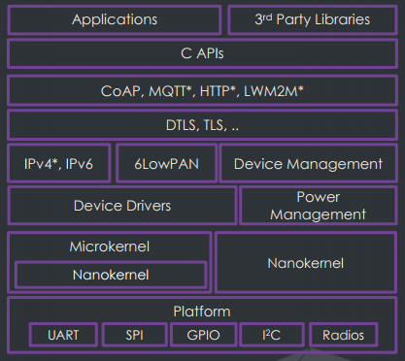
Spaces
Kernel Mode only
No user space
Highly Configurable, Highly Modular
Single Address space(library Based RTOS)

Slide 9
Architecture
Zephyr Kernel is monolithic modular
MicroKernel & NanoKernel
NanoKernel-
The absolute essential RTOS services are within the nanokernel.
This kernel is responsible for executing the highest priority procedures from interrupts to background tasks
The nanokernel is based on a series of small threads dubbed fibers
These fibers will only execute one task at a time

Slide 10
How Kernel Works?
NanoKernel will typically be limited to be used by devices with extremely low memory footprints like environmental sensors, RFID tags and LEDs
most IoT devices will be able to use Zephyr’s full microkernel
This will allow for greater multitasking abilities and services including:
memory pools –dynamic memory allocation
memory maps-files, code, or objects be brought into system memory
a mailbox-a storage location

Slide 11

Microkernel
Tasks sitting in the microkernel are scheduled by a server file in the nanokernel
highest priority tasks are to be run within the nanokernel and for interrupts to be run within the nanokernel without hindrance
Once all the fibers have finished executing a task, the server fiber will then send the nanokernel the next highest priority task
If two tasks are tied, then the one that has been sitting in the microkernel the longest will be selected
The idea of the two kernel system is to keep memory stacks small and to allocate processes to the cloud whenever possible

Slide 12
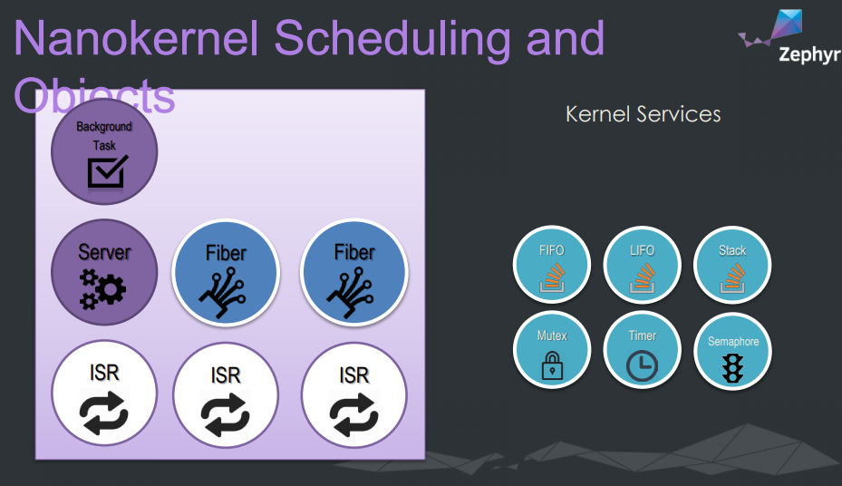

Slide 13
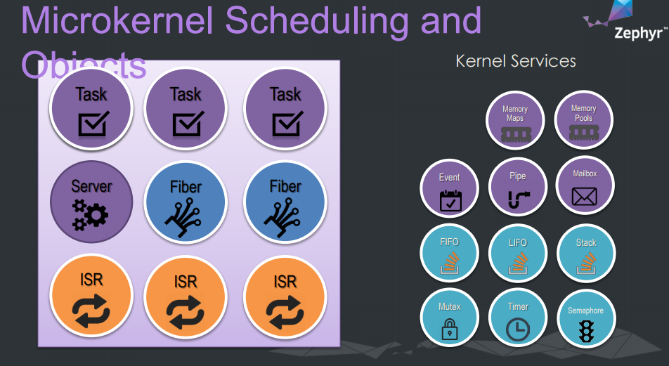

Slide 14
“Kernel-Less”
One single executable which is executed in one single address space
No loader is required to dynamically load applications at run-time
Minimizing the operating system code System calls are implemented as function calls
No context switches are required when calling an operating system call
Lack of security through hardware memory separation
Application and operating system calls are implemented as thread in the same address space
Bugs in one part of the system can affect the whole system

Slide 15
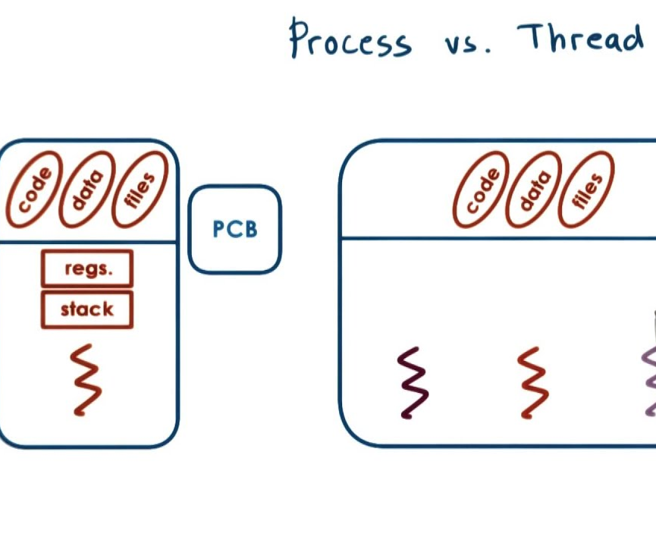
2.Process/Thread

Slide 16
Process/Thread Handling
Thread-A thread is a kernel object that is used for application processing that is too lengthy or too complex to be performed by an ISR
Any number of threads can be defined by an application (limited only by available RAM)
Each thread is referenced by a thread id that is assigned when the thread is spawned

Slide 17

Life Cycle of a thread
Thread Creation
Thread Aborting
Thread Termination
Thread suspension

Slide 18
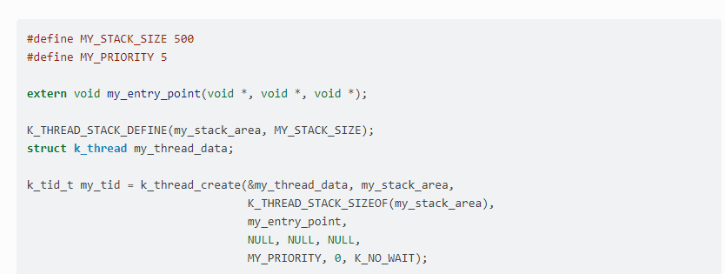
Thread Creation Vs Definition

Slide 19
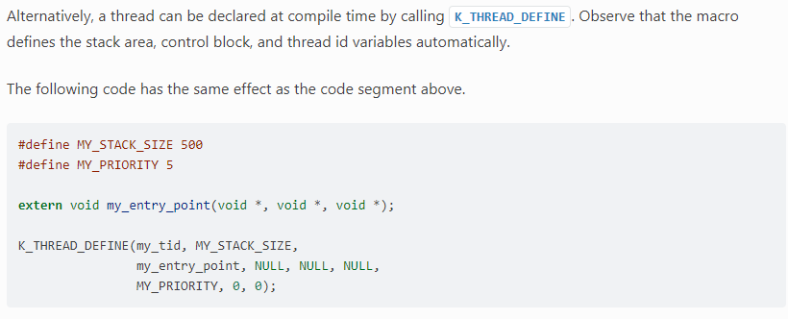
Definition

Slide 20
Properties Of threads
A stack area, which is a region of memory used for the thread’s stack
A thread control block for private kernel bookkeeping of the thread’s metadata. This is an instance of type k_thread
An entry point function, which is invoked when the thread is started. Up to 3 argument values can be passed to this function.
A scheduling priority, which instructs the kernel’s scheduler how to allocate CPU time to the thread

Slide 21
Thread States
Ready Vs Unready
The following factors make a thread unready:
The thread has not been started.
The thread is waiting for a kernel object to complete an operation. (For example, the thread is taking a semaphore that is unavailable.)
The thread is waiting for a timeout to occur.
The thread has been suspended.
The thread has terminated or aborted.

Slide 22
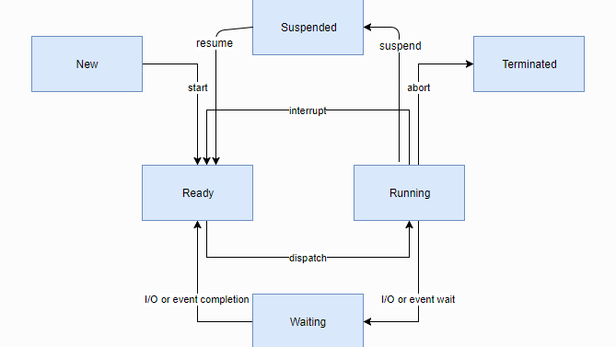

Slide 23

Thread Priority
Numerically lower priorities takes precedence over numerically higher values
The scheduler distinguishes between two classes of threads, based on each thread’s priority.
A cooperative thread has a negative priority value. Once it becomes the current thread, a cooperative thread remains the current thread until it performs an action that makes it unready
A preemptible thread has a non-negative priority value. Once it becomes the current thread, a preemptible thread may be supplanted at any time if a cooperative thread, or a preemptible thread of higher or equal priority, becomes ready

Slide 24

The scheduler determines which thread is allowed to execute at any point in time(current thread)
Whenever the scheduler changes the identity of the current thread, or when execution of the current thread is supplanted by an ISR
the kernel first saves the current thread’s CPU register values
These register values get restored when the thread later resumes execution

Slide 25
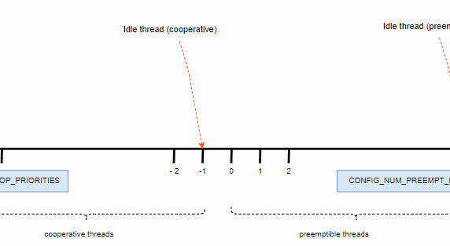

Slide 26

Scheduling
The kernel’s scheduler selects the highest priority ready thread to be the current thread
When multiple ready threads of the same priority exist, the scheduler chooses the one that has been waiting longest
Zephyr provides multiple comprehensive set of thread scheduling choices:
Cooperative and Preemptive Scheduling
Earliest Deadline First (EDF)
Round Robin Scheduling
Multiple queuing strategies

Slide 27

Cooperative Time Slicing
if a cooperative thread performs lengthy computations, it may cause an unacceptable delay in the scheduling of other threads, including those of higher priority and equal priority
Solution to this
Calling k_yield() puts the thread at the back of the scheduler’s prioritized list of ready threads, and then invokes the scheduler
Calling k_sleep() makes the thread unready for a specified time period

Slide 28
Preemptive Time Slicing
Once a preemptive thread becomes the current thread, it remains the current thread until a higher priority thread becomes ready, or until the thread performs an action that makes it unready
A long delay
Solution-Cooperative/Scheduler Slicing

Slide 29

Scheduler Locking
A preemptible thread that does not wish to be preempted while performing a critical operation can instruct the scheduler to temporarily treat it as a cooperative thread by calling k_sched_lock()
Restore after critical section is over
k_sched_unlock()

Slide 30
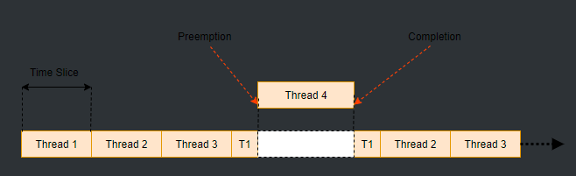
Responsiveness
Hard Time (RTOS)

Slide 31
Synchronization
Semaphores
Mutexes

Slide 32
Semaphores
A semaphore is a kernel object that implements a traditional counting semaphore
Properties
Count
Limit
Methods
Defining a semaphore
Giving a semaphore
Taking a semaphore

Slide 33
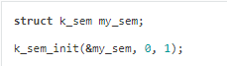
Defining a semaphore
A semaphore is defined using a variable of type struct k_sem. It must then be initialized by calling k_sem_init().
The following code defines a semaphore, then configures it as a binary semaphore by setting its count to 0 and its limit to 1.

Slide 34

Giving a semaphore
A semaphore is given by calling k_sem_give(). The following shows it
void input_data_interrupt_handler(void *arg)
{
/* notify thread that data is available */
k_sem_give(&my_sem); ...
}

Slide 35

Mutexes
A mutex is a kernel object that implements a traditional reentrant mutex
A mutex allows multiple threads to safely share an associated hardware or software resource by ensuring mutually exclusive access to the resource

Slide 36

Properties
Lock Count
Owning thread
A thread that needs to use a shared resource must first gain exclusive rights to access it by locking the associated mutex
If the mutex is already locked by another thread, the requesting thread may choose to wait for the mutex to be unlocked
After locking a mutex, the thread may safely use the associated resource for as long as needed

Slide 37

Defining A Mutex
A mutex is defined using a variable of type struct k_mutex
struct k_mutex my_mutex;
k_mutex_init(&my_mutex);
Locking: A mutex is locked by calling k_mutex_lock().

Slide 38
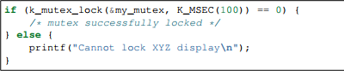
Example
The following code waits up to 100 milliseconds for the mutex to become available, and gives a warning if the mutex does not become available

Slide 39
Unlocking a mutex
A mutex is unlocked by calling k_mutex_unlock()

Slide 40
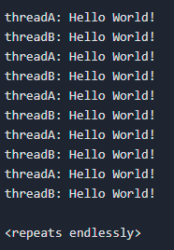
Classical Example
A simple application that demonstrates basic sanity of the kernel
Two threads (A and B) take turns printing a greeting message to the console, and use sleep requests and semaphores to control the rate at which messages are generated

Slide 41

3.Resource Management

Slide 42
3.Resource Management
Memory Slab
Defining a slab
Allocating a memory block
Releasing memory
Heap Memory Pool

Slide 43
Memory Slab
A memory slab is a kernel object that allows memory blocks to be dynamically allocated from a designated memory region
All memory blocks in a memory slab have a single fixed size, allowing them to be allocated and released efficiently and avoiding memory fragmentation concerns

Slide 44
Defining a slab
Memory slab is defined by: struct k_mem_slab
The following code defines and initializes a memory slab that has 6 blocks that are 400 bytes long, each of which is aligned to a 4-byte boundary
struct k_mem_slab my_slab;
char __aligned(4) my_slab_buffer[6 * 400];
k_mem_slab_init(&my_slab, my_slab_buffer, 400, 6);

Slide 45
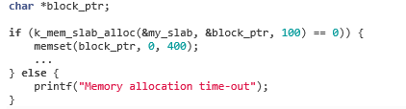
Allocating a Memory Block
A memory block is allocated by calling k_mem_slab_alloc()
The following code builds on the example above, and waits up to 100 milliseconds for a memory block to become available, then fills it with zeroes. A warning is printed if a suitable block is not obtained.

Slide 46
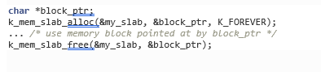
Releasing a Memory Block
A memory block is released by calling k_mem_slab_free()
The following code builds on the example above, and allocates a memory lock, then releases it once it is no longer needed

Slide 47

Heap Memory Pool
The heap memory pool is a predefined memory pool object that allows threads to dynamically allocate memory from a common memory region in a malloc()-like manner
Allocating
Deallocating

Slide 48
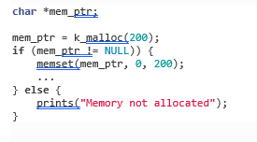
Allocating Memory

Slide 49
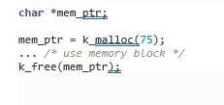

Deallocating Memory
free()

Slide 50

4.Memory Management

Slide 51

4.Memory Management
Demand Paging
Page Statistics
Paging Algorithm

Slide 52
Demand Paging
Demand paging provides a mechanism where data is only brought into physical memory as required by current execution context
There are functions where paging in and out can be invoked manually using k_mem_page_in() and k_mem_page_out()
k_mem_page_in() can be used to page in data pages in anticipation that they are required in the near future.
This is used to minimize number of page faults as these data pages are already in physical memory, and thus minimizing latency
k_mem_page_out() can be used to page out data pages where they are not going to be accessed for a considerable amount of time

Slide 53
Paging Statistics
Paging statistics can be viewed as:
Overall statistics via k_mem_paging_stats_get()
Per-thread statistics via k_mem_paging_thread_stats_get()
Execution time histogram of backing store doing page-in via k_mem_paging_histogram_backing_store_page_in_get()

Slide 54
Paging Algorithm
Not recently used algorithm (NRU)
The paging algorithm is used to determine which data page and its corresponding page frame can be paged out to free up a page frame for the next page in operation
There are two functions which are called from the kernel paging code
k_mem_paging_eviction_init() is called to initialize the paging algorithm.
k_mem_paging_eviction_select() is called to select a data page to evict

